Slide 1
Teachings of
LORD CAITANYA
IPBYS Prison Outreach Program
FCC Butner – LSCI (Federal Prison)
Apr 27, 2017
By: Dr. BK Dasa (Dr. Raj)
Session-4
Notes:
Good after noon..
Welcome to the 4th session of this class.
Last week, we went over the mood and life of a real devotee
Trnad Api Sunecena – More humble than a blade of grass
Na Dhanam Na Janam – No desire for material possessions

Slide 2
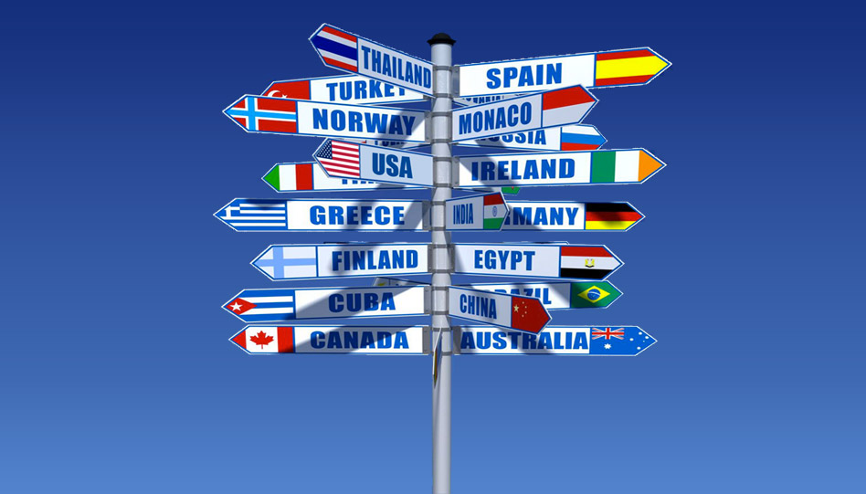
Destinations are MANY and DIFFERENT…!
Notes:
As we know, every destination is different.
And there are so many destinations..

Slide 3
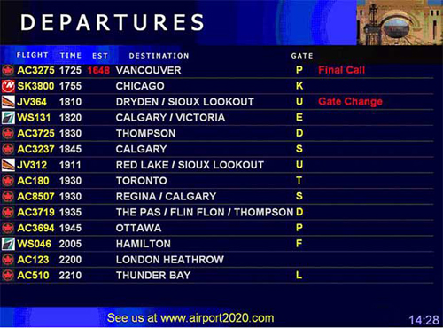
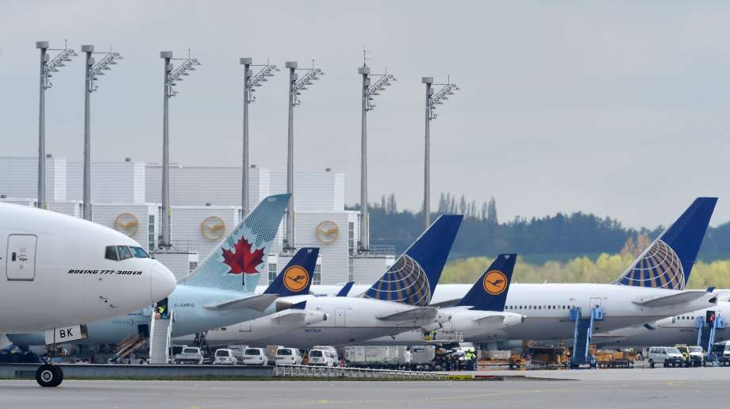
Notes:
If you want to go to London, you will get into the London flight..
If you want to go to Newyork, you will get into Newyork plane.
You can’t just like that take any plane to go anywhere.

Slide 4
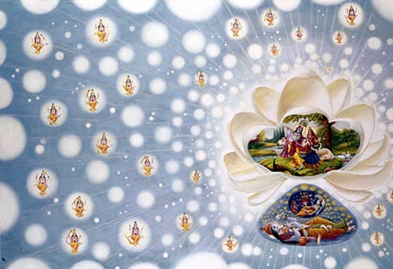
Spiritual world is way big with varieties…
One Supreme God, but many demi-gods..
Notes:
Spiritual world is way bigger than material worlds..
Material worlds have different galaxies, super cluster, and so on..
Veda says that spiritual world is way bigger than all material worlds.
Spiritual world also has many many destinations..
Each one is different..
Why? According to the desires and goal, there are spiritual worlds.
Each religion has a destination.
Many take us to different heavens. They are not same.
And God in different names, forms and glory is in each heaven.

Slide 5
MANTRA | DESTINATION
OM | Nirvana / Brahman
All Vedic Mantras | Different Heavens
Om Namo Narayanaya | Vaikuntha
Om Nama Shivaya | Shiva Loka
Sri Rama mantra | Saketh
Ganesha Mantra | Ganesh Loka
Maha Mantra (Hare Krsna) | Goloka
Notes:
Similar to various religions that take us to different heavens,
There are different types of names of God called mantra.
Every mantra has a unique destination..
For example, by chanting Om Nama Shivaya, one goes to Shiva Loka (Heaven)
If one chants the names as Allah, he/she goes to that heaven.
Our sastras say that there unlimited number of heavens each presided by forms of God.

Slide 6
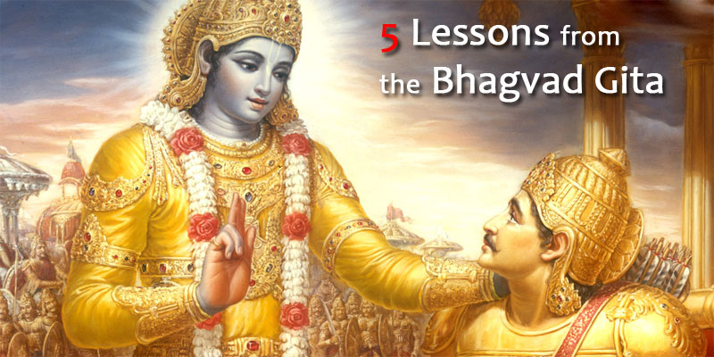
Gita says, “There is only one Supreme God”
Notes:
In Bhagavad Gita, it clearly says that there is only one Supreme God.
All others are only assisting the Supreme Lord in running everyhing.
Gita says that “Lord Krishna is the only one Supreme God”
Above Him, there is nothing higher.

Slide 7
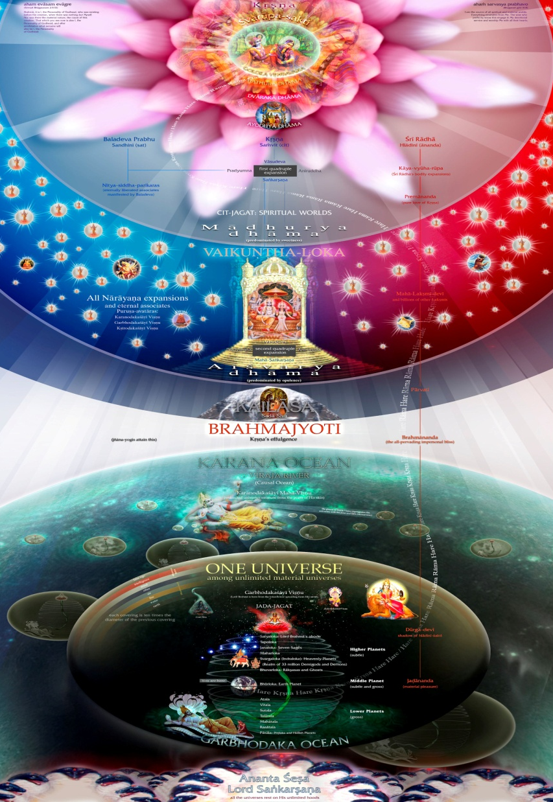
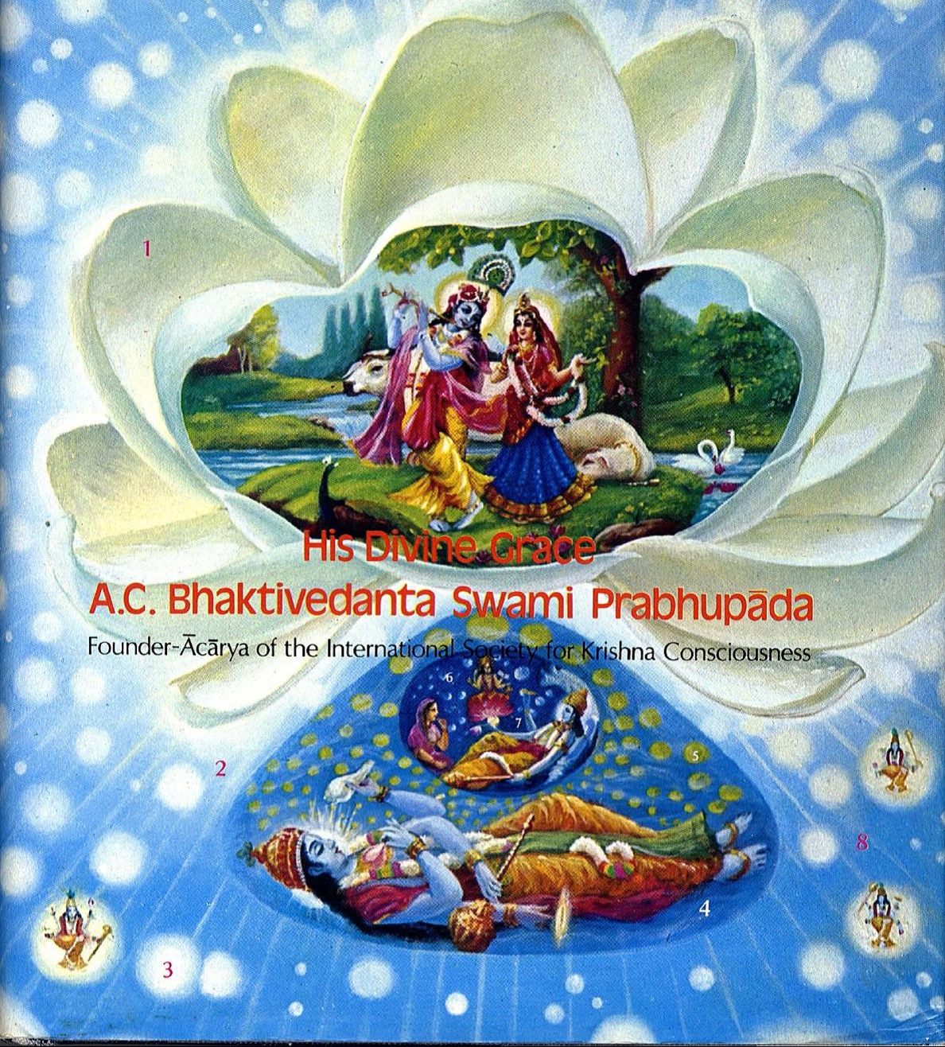
Notes:
If you see this picture, it shows that there are unlimited universes.
Mahavishnu breaths out and breaths in innumerable universes.
Beyond Him is Lord Krishna.
Lord Krishna resides in the highest abode called “Goloka”
Only the purest devotees can go here.
Others go to different heavens and resides with different forms of God.

Slide 8
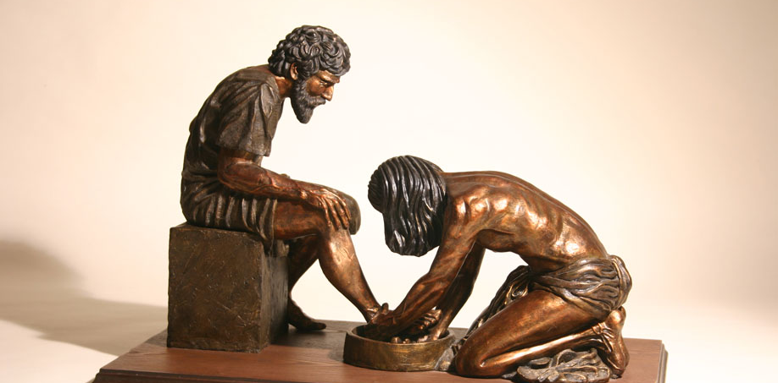
Abd-Allah – Slave of God in Spiritual world?
Notes:
A Question may come:
“How does our life will look in the spiritual world?”
As many religions say: Will we live as a servant there?
The answer is YES!
Then, will that be full of misery?
We will see now!

Slide 9
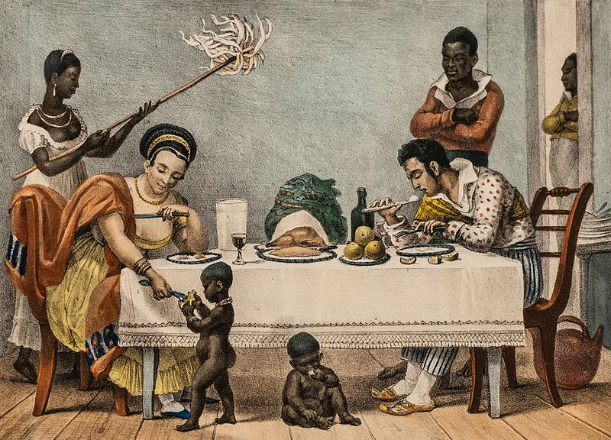
Notes:
In our material world, SLAVE is a looser and suffers.
The master is a winner and enjoys.

Slide 10
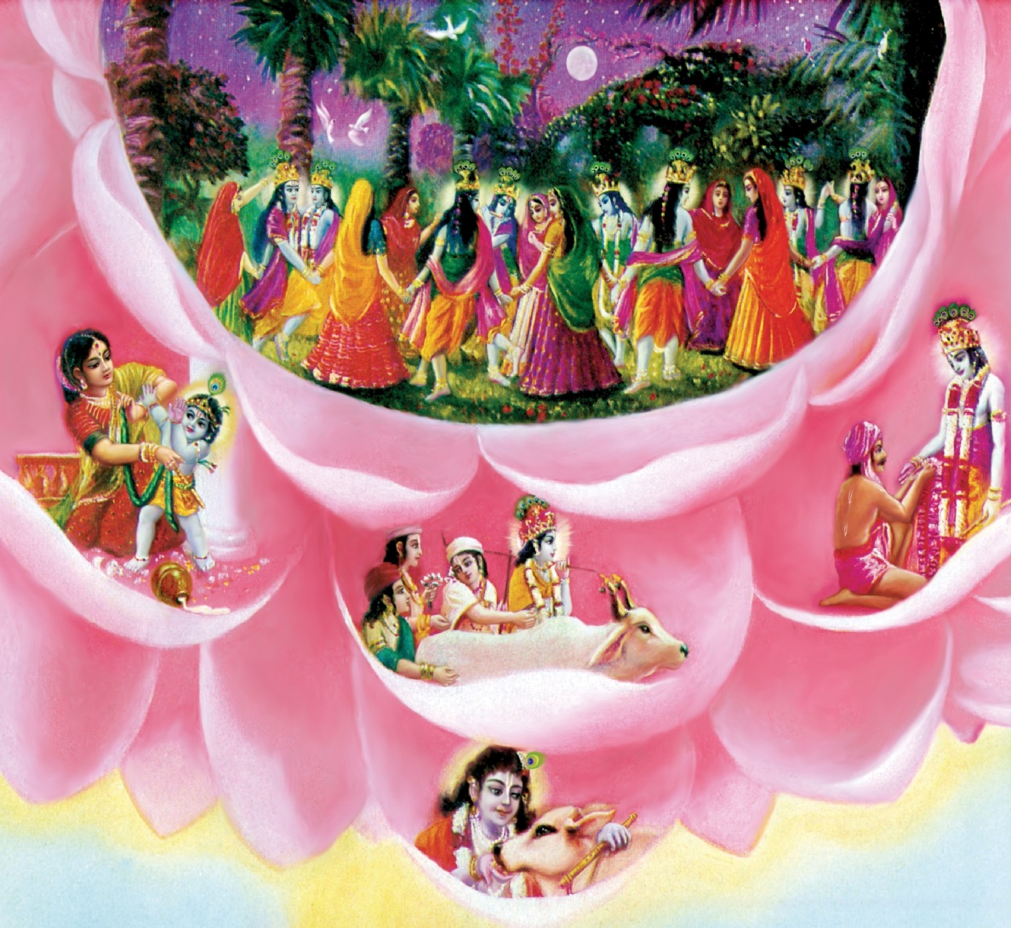
What about the Spiritual world?
Notes:
In the Spiritual world, it is completely opposite..
There a Slave is much more happier than the master!
Can we believe this?
Why a slave is happier there?
Because it is due to the Love of God..
And God reciprocates our love.

Slide 11
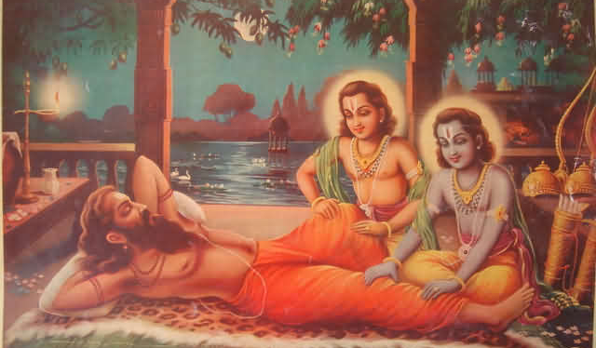
Notes:
There the Lord even serves His dear devotees some times!
The love is reciprocated.

Slide 12
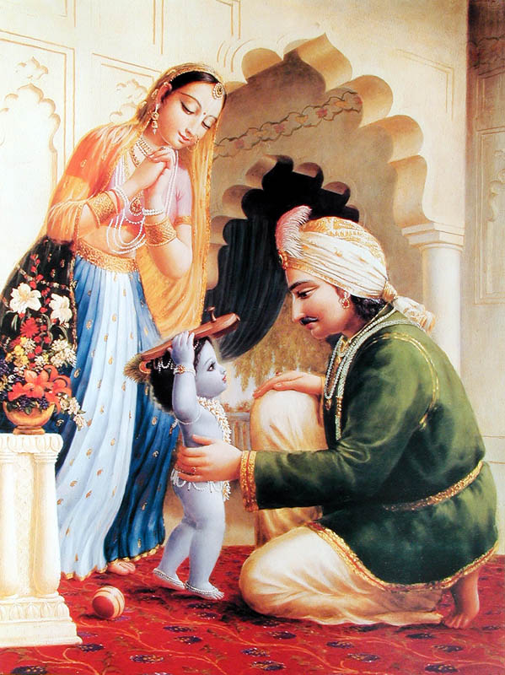
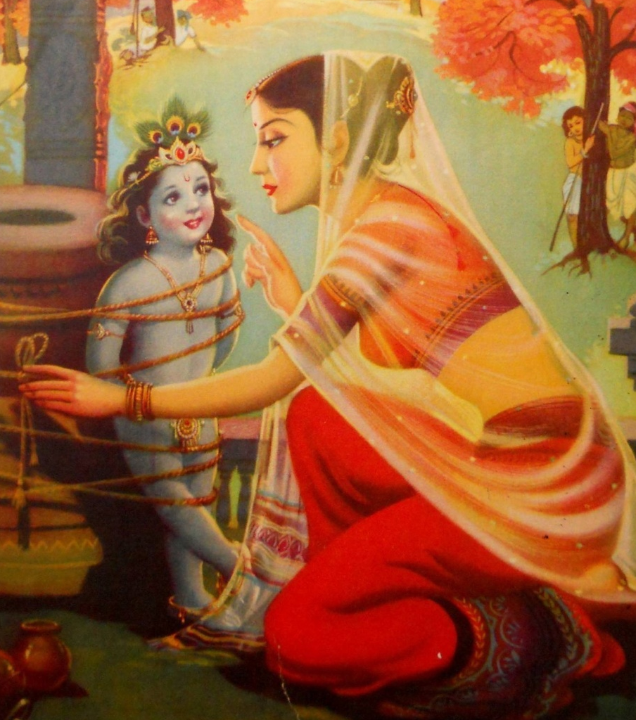
Notes:
He even carries the work of His dear devotees..
His devotees even tie Him out of love..

Slide 13
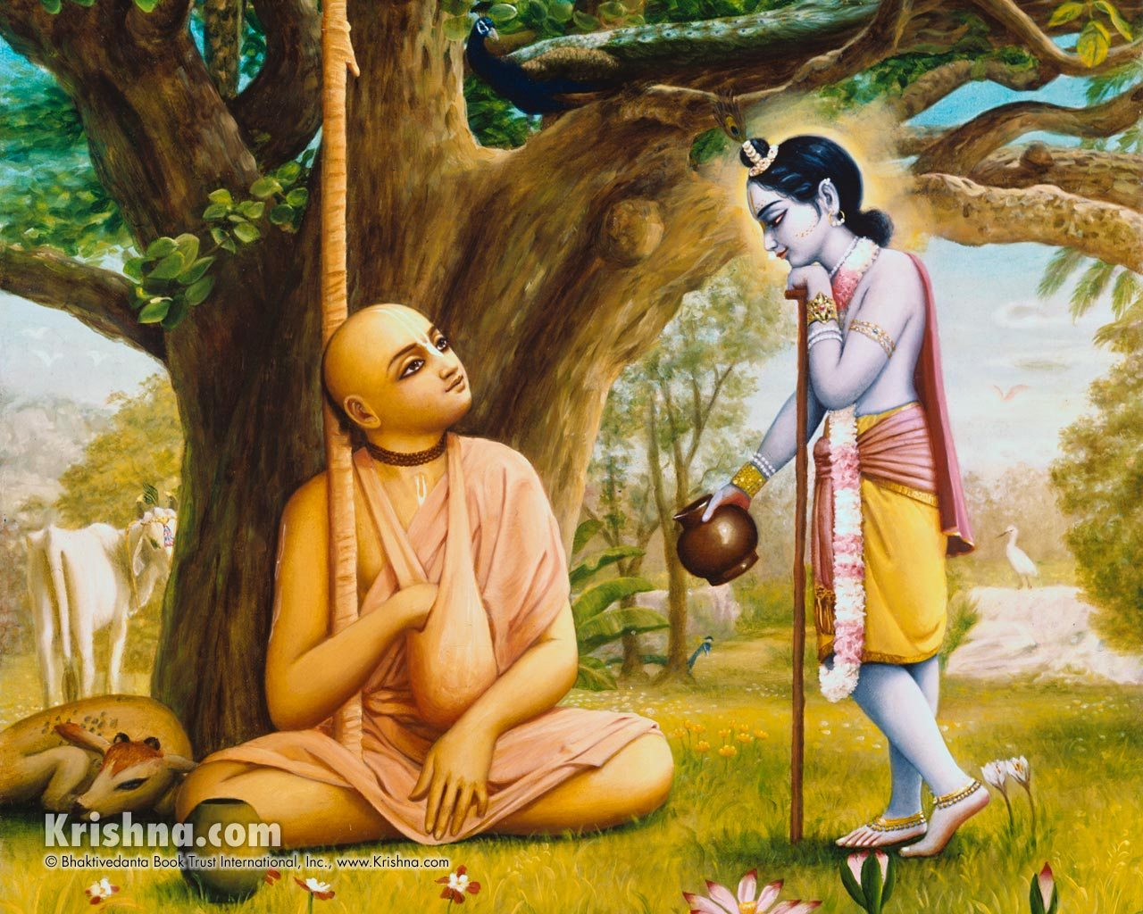
Notes:
Lord Krishna personally takes care of every one of His devotees.
This is a saint named ‘Madhavendra Puri”
Never goes to even beg.
Whatever comes he eats.
Once Krishna Himself came with a pot of milk.
Then he vanished, and came in the dream..

Slide 14
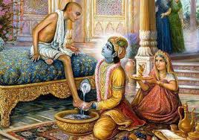
Notes:
He even washes the feet of His dear devotees and sprinkles that water as divine.
He is never envious..
Here Lord Krishna is washing the feet of Sudama Vipra a very pure devotee.
Lord Krishna thinks that His devotees are actually higher than Himself..!

Slide 15
ādaraḥ paricaryāyāṁ
sarvāṅgair abhivandanam
mad-bhakta-pūjābhyadhikā
sarva-bhūteṣu man-matiḥ … S.B 11.19.21
Therefore, not only is a devotee of the Lord more powerful than the Lord, but also worship of the devotee is considered more effective than direct worship of the Lord..
Notes:
He said that His devotee is higher than Himself
and more powerful than Himself.
He also said that worshipping His pure devotee
is more effective than direct worship of the Lord.

Slide 16
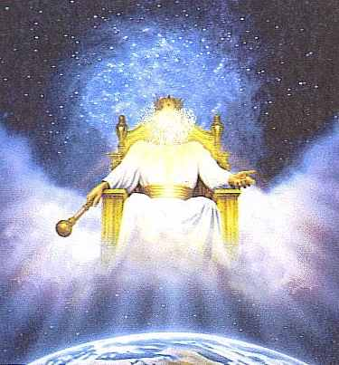
Notes:
I heard a story from my elders..
It was from Bible they said,
Once, a soul got influenced by ignorance by influence of Satan..
Until then it was happily living in heaven..
But now it asked to get its freedom back..
Reluctantly, God gave it..
The satan was happy!
Why? Satan was sure by the freedom got by a Jiva soul
Satan was sure he can trick to use it for bad things..

Slide 17
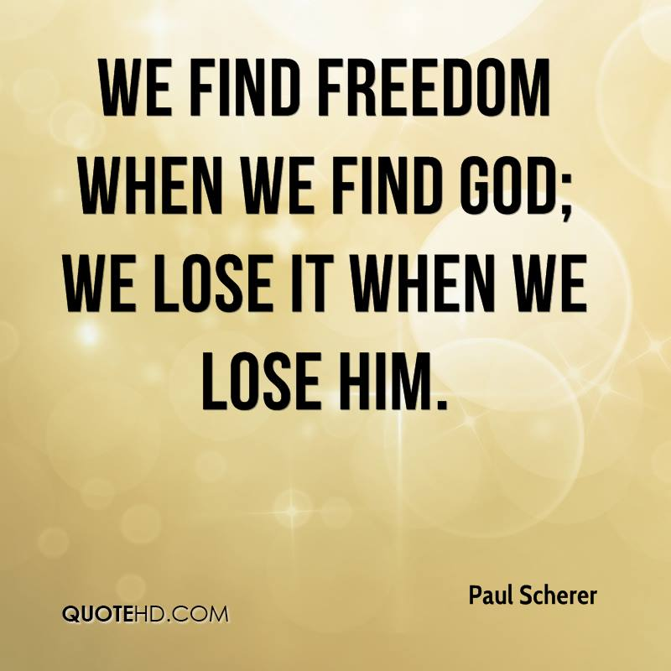
Notes:
We, the fallen souls to this material world is like fallen satan in one way..
We wanted to be FREE from God..
In that, we actually are the losers!
In Vedic Scripture, there is nothing like satan.
Satan is the darkness..
When God, the light comes, automatically darkness goes away.

Slide 18
Notes:
So, what is the Solution to go back to God?
Very easy!
Just surrender and give our FREEDOM back..
By surrendering to the Supreme Lord, we are in good hands.
By surrendering our freedom, we become His eternal slave!
Yes, eternal..
How?
This is what Sri Caitanya Mahaprabhu says.

Slide 19
ayi nanda-tanūjakińkaram
patitam mām visame bhavāmbudhau
krpayā tava pāda-pańkaja- sthita-
dhūlī-sadrśam vicintaya …(Sikshashtakam - 5)
[ O son of Nanda Maharaja! Please be merciful upon me, your eternal servant, fallen in the dreadful ocean of material existence as a result of my fruitive actions. Like a particle of dust affixed to Your lotus feet, kindly accept me forever as your purchased servant.]
Notes:
O Lord Krishna! Who came as the son of Nanda Maharaja!
Please take me as you take a dust affixed your lotus like feet.
Kindly accept me as your ETERNAL Servant!
Meaning that I surrender my FREEDOM back to you!
I should not have got the FREEDOM.
Now I am giving it back, and sign a contract to be SLAVE forever!
PURCHASED SERVANT!!
So, we might have stopped Slavery here..
But Slavery is always there in the Spiritual World.
But it is the happiest Slavery!

Slide 20
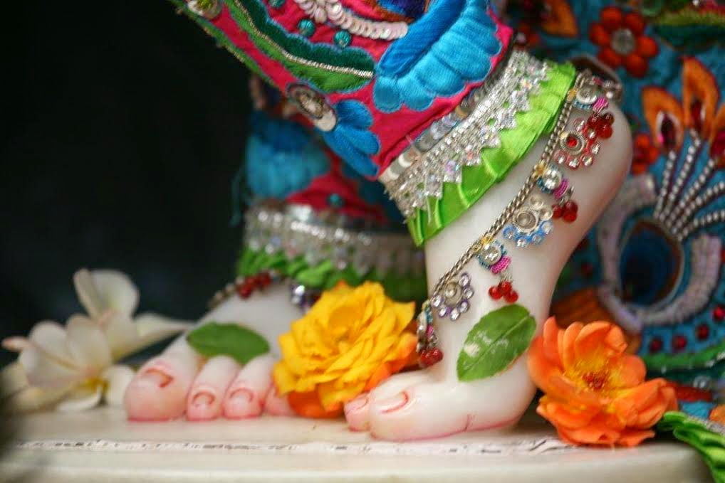
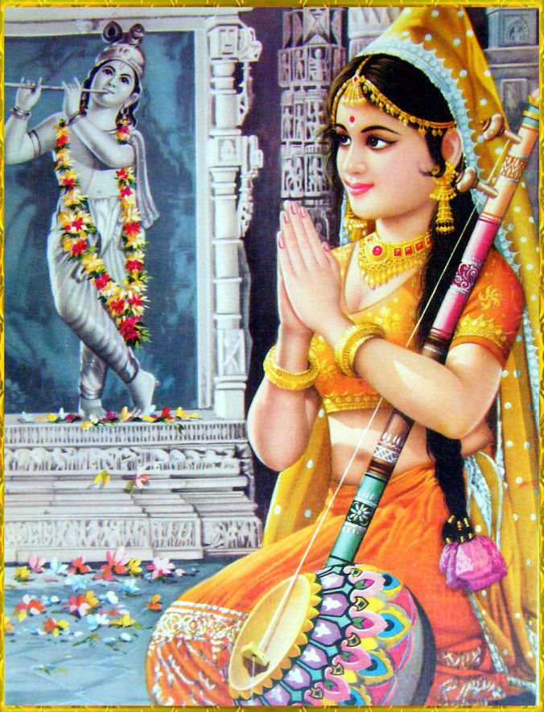
Notes:
Who will want to surrender like this?
Not every one!
Only those who are intelligent and fortunate to get mercy!
Others won’t surrender.
They want to be the masters in this world,
And suffer again and again..
They are fooled by the flickering happiness if at all any!

Slide 21
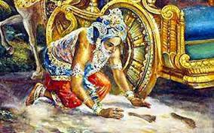
Notes:
We should be really going after his feet..
We should be hankering for the lotus feet of Lord Krishna

Slide 22
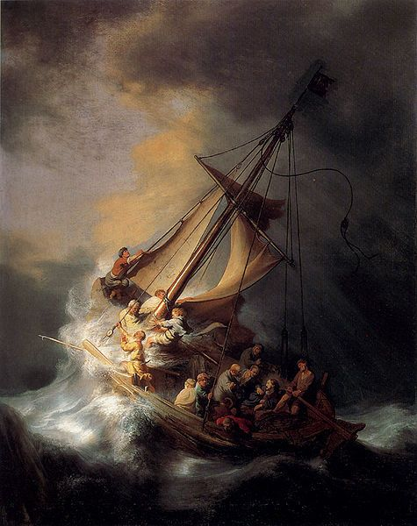
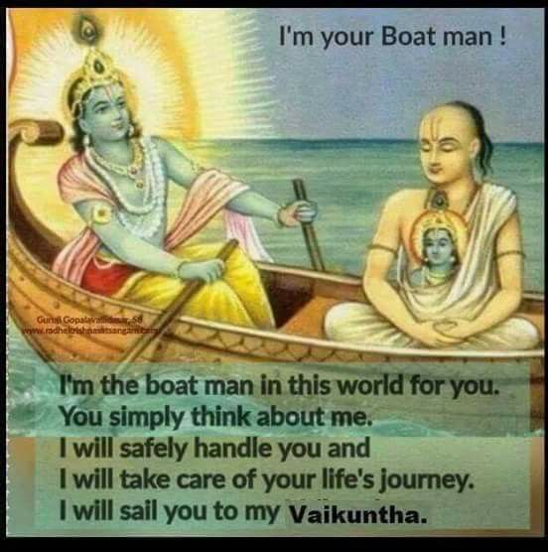
Notes:
By we surrendering, Lord Krishna
Takes over our responsibility
Our life without Him is like a boat caught in the storm.
We do not know what to do and where to go.
Once we surrender, he takes over the control..
We will have a very safe journey..
And go back to His own abode.!

Slide 23
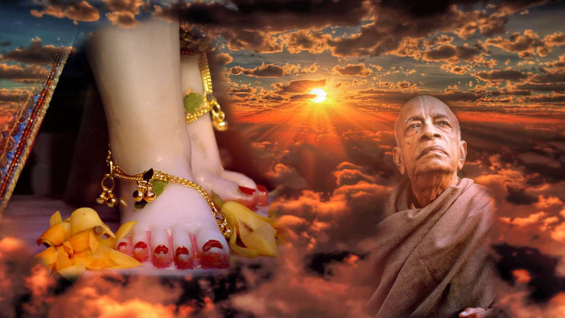
But, what really happens when we surrender?
Notes:
Now, when we REALLY surrender to Krishna,
Something mysterious happens..
This happens only if we FULLY surrender..
100% surrender.
What happens to us?

Slide 24
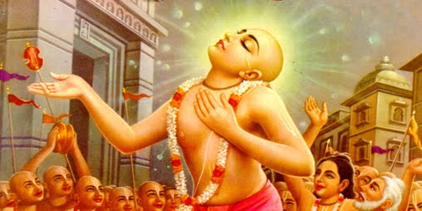
We receive Pure Love and Mercy
Notes:
We receive PURE Love and Mercy from Lord Krishna
We become so pure..
All our sins get washed away!
Why pure love? And where does it come from?

Slide 25
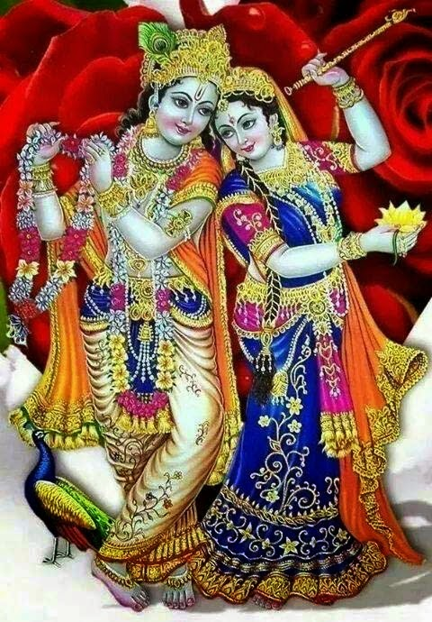
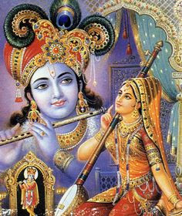
Notes:
Why do we get pure Love..?
Because, Krishna is God of Love..
So, when we surrender,
We overflow with love for Krishna.
And Krishna overflows with love for us..!
We cry and cry in bliss and ecstacy!

Slide 26
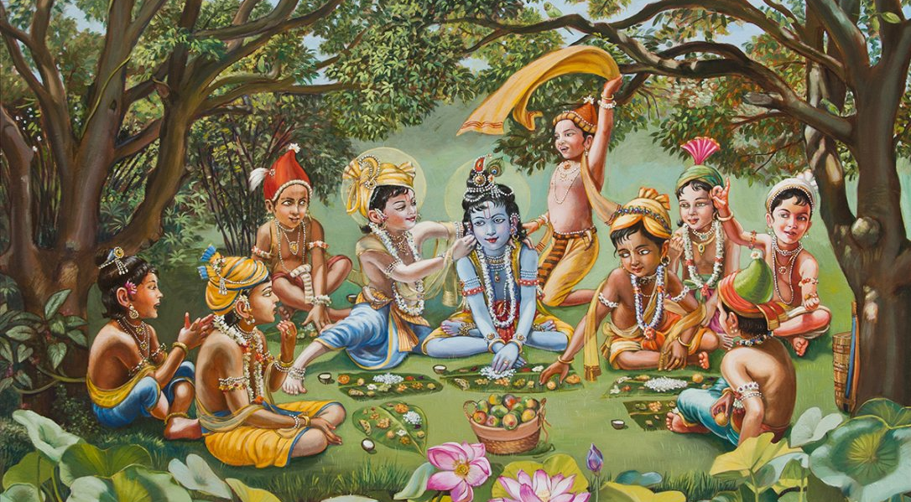
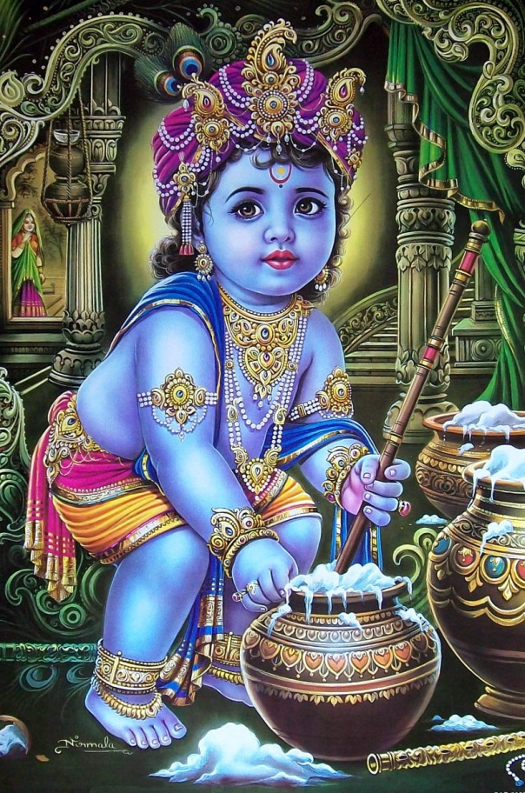
Notes:
And we forget that we are actually His servants..
Instead, we think He is not even the Supreme God!
He is just our object of Love..
We do not see any difference between Him and us.
We play with Him..
We eat with Him
We dance with Him
We even tease Him!

Slide 27
nayanam galad-aśru-dhārayā
vadanam gadgada-ruddhayāgirā
pulakairnicitam vapuh kadā
tavanāma-grahane bhavisyati ... Sikshashtakam-6
[ O Lord! When will my eyes be filled with a stream of tears? When will my voice choke up? And when will the hairs of my body stand erect in ecstacy as I chant Your holy name?]
Notes:
In the Spiritual world, every moment you are in ecstacy!
This is what the state, Lord Caitanya is explaining to us..
Showing us how to be a devotee in this material world,
He hankers for the loving tears flowing from our eyes onto our cheeks
when chanting the holy names of Lord Krishna!

Slide 28
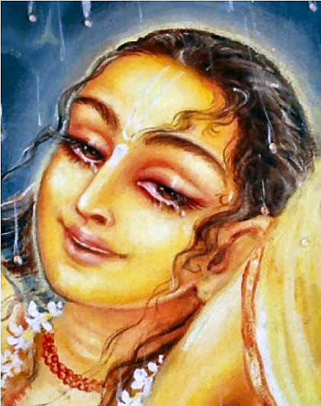
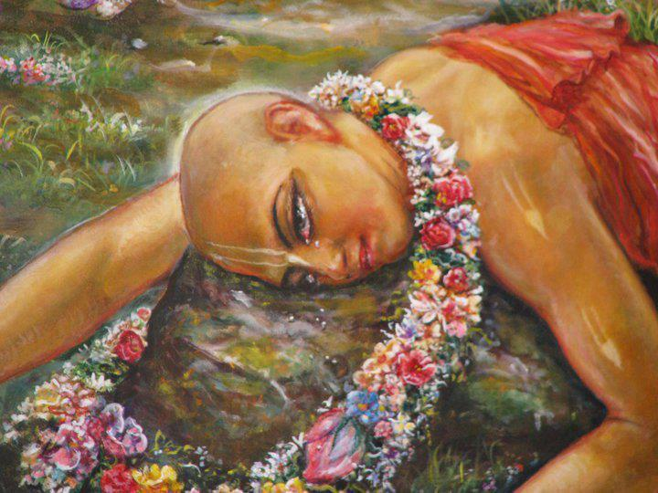
Notes:
Lord Caitanya showed this love for Lord Krishna practically..
That was why He came down into this world..
To show the power of Lord’s name..

Slide 29
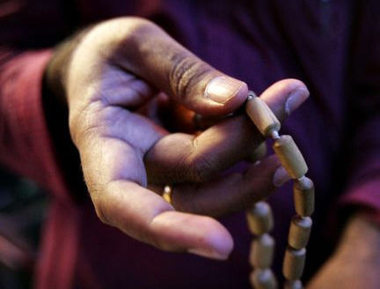
Notes:
Love of God comes from chanting His holy names.
Getting Love for Krishna is not ordinary..
It is extremely rare..

Slide 30
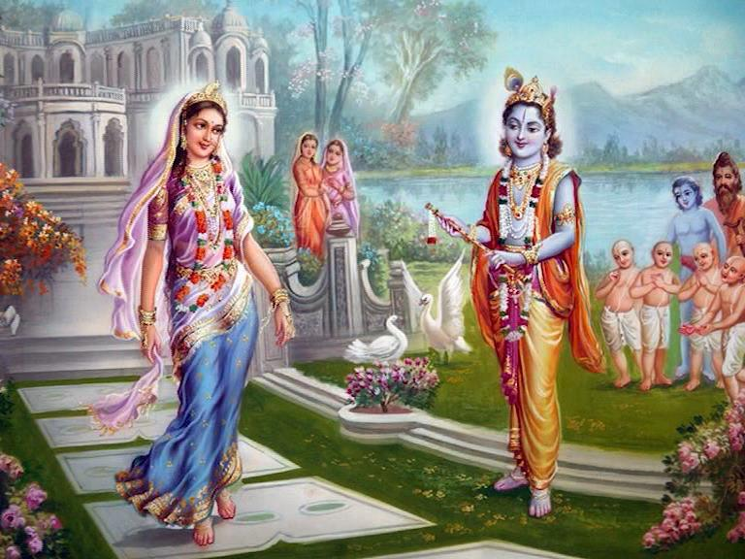
Hare Krsna Hare Krsna, Krsna Krsna Hare Hare!
Hare Rama Hare Rama, Rama Rama Hare Hare!
Notes:
So, we all should be singing and chanting the holy names of Lord…
Here is a Nama Sankirtan!

Slide 31
Wish every one of you will engage in chanting the holy names of the Lord!
Notes:
Thank you..
Next class, next Thursday – same time, same place..
See you all.
Hare Krishna!

